Slide 1
CS 355/555
Probability and Statistics for CS
Baocheng Geng
Lecture 9, 02/05/2025
CS 355/555 Probability and Statistics for CS

Slide 2



Counting, Permutation and Combination
Introduction
Counting
Permutation and Combination
CS 355/555 Probability and Statistics for CS

Slide 3
Copyright Statement
Copyright Statement
Materials prepared for and/or included in this course are protected by copyright law. They are intended to be used only by students enrolled in this course during the current term and should not be further disseminated without prior permission from the course instructor.
CS 355/555 Probability and Statistics for CS

Slide 4
Quick Announcement
First Midterm Feb 21st

Slide 5
Counting - Sum Rule
If A has n and B has m items and A ∩ B = ϕ then A ∪ B has
m + n items.
|A ∪ B| = |A| + |B|
CS 355/555 Probability and Statistics for CS
4/24 11:00

Slide 6
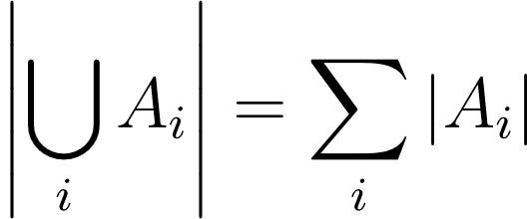
Counting - Sum Rule
If A has n and B has m items and A ∩ B = ϕ then A ∪ B has
m + n items.
|A ∪ B| = |A| + |B|
Generalize to more than two disjoint sets
CS 355/555 Probability and Statistics for CS
4/24 11:00

Slide 7
Counting - Sum Rule
If A has n and B has m items and A ∩ B = ϕ then A ∪ B has
m + n items.
|A ∪ B| = |A| + |B|
Generalize to more than two disjoint sets
Rephrase: If there are n ways to do A and m ways to do B and there is no way to do A and B then there are m + n ways to do A or B.
CS 355/555 Probability and Statistics for CS
4/24 11:00

Slide 8
Counting - Inclusion-Exclusion Principle
If A has n and B has m items and A ∩ B has p items, then A ∪ B
has m + n − p items.
Venn diagram
|A ∪ B| = |A| + |B| − |A ∩ B|
CS 355/555 Probability and Statistics for CS
5/24 11:00

Slide 9
Counting - Inclusion-Exclusion Principle
If A has n and B has m items and A ∩ B has p items, then A ∪ B
has m + n − p items.
Venn diagram
|A ∪ B| = |A| + |B| − |A ∩ B|
Generalize to more than two
|A∪ B ∪ C| = |A|+|B|+|C|−|A∩ B|−|A∩ C|−|B ∩ C|+|A∩ B ∩ C|
CS 355/555 Probability and Statistics for CS
5/24 11:00

Slide 10
Counting - Product Rule
Product Rule
If there are n ways to do A and m ways to do B, and A and B are independent then there are m × n ways to do A and B.
CS 355/555 Probability and Statistics for CS
6/24 11:00

Slide 11
Counting - Product Rule
Example first die even and second die odd.
First die: 2,4,6
Second die: 1,3,5
Outcomes: (2,1), (2,3), (2,5), (4,1), (4,3), (4,5), (6,1), (6,3), (6,5)
CS 355/555 Probability and Statistics for CS

Slide 12
Counting - Product Rule
Product Rule
If there are n ways to do A and m ways to do B, and A and B are independent then there are m × n ways to do A and B.
Cross Product
If a ∈ A there are n possible as. If b ∈ B there are m possible bs. So, there are m × n possible (a, b)s.
CS 355/555 Probability and Statistics for CS
6/24 11:00

Slide 13
The Pigeonhole Principle
The Pigeonhole Principle
The pigeonhole principle states that if n items are put into m containers, with n > m, then at least one container must contain more than one item.
CS 355/555 Probability and Statistics for CS

Slide 14
The Pigeonhole Principle
The Pigeonhole Principle
The pigeonhole principle states that if n items are put into m containers, with n > m, then at least one container must contain more than one item.
How many people do you need to have at the party to ensure that at least two people have a birthday in the same month?
CS 355/555 Probability and Statistics for CS

Slide 15
How many ways can 4 bits be ordered that start or end with 1?
Example
CS 355/555 Probability and Statistics for CS
9/24 11:00

Slide 16
How many ways can 4 bits be ordered that start or end with 1?
A = start with 1 (8)
Example
CS 355/555 Probability and Statistics for CS
9/24 11:00

Slide 17
Example
How many ways can 4 bits be ordered that start or end with 1?
A = start with 1 (8)
B = end with 1 (8)
CS 355/555 Probability and Statistics for CS
9/24 11:00

Slide 18
Example
How many ways can 4 bits be ordered that start or end with 1?
A = start with 1 (8)
B = end with 1 (8)
A ∩ B = start and end with 1 (4)
CS 355/555 Probability and Statistics for CS
9/24 11:00

Slide 19
Example
How many ways can 4 bits be ordered that start or end with 1?
A = start with 1 (8)
B = end with 1 (8)
A ∩ B = start and end with 1 (4) Answer: 8 + 8 - 4 = 12
Just as easily: how many start and end with 0?
CS 355/555 Probability and Statistics for CS
9/24 11:00

Slide 20
There are 6 students. How many ways can they stand in a line?
Permutations
CS 355/555 Probability and Statistics for CS
4/29 16:08

Slide 21
Permutations
There are 6 students. How many ways can they stand in a line?
First, draw six buckets:
CS 355/555 Probability and Statistics for CS
4/29 16:08

Slide 22
Permutations
There are 6 students. Any one of them can be first.
CS 355/555 Probability and Statistics for CS
5/29 16:08

Slide 23
Permutations
There are 6 students. Any one of them can be first.
6
CS 355/555 Probability and Statistics for CS
5/29 16:08

Slide 24
There are 5 students left. Any one of them can be second.
Permutations
CS 355/555 Probability and Statistics for CS
6/29 16:08

Slide 25
There are 5 students left. Any one of them can be second.
Permutations
6 | 5
CS 355/555 Probability and Statistics for CS
6/29 16:08

Slide 26
Permutations
There are 4 students left. Any one of them can be third.
CS 355/555 Probability and Statistics for CS
7/29 16:08

Slide 27
Permutations
There are 4 students left. Any one of them can be third.
6 | 5 | 4
CS 355/555 Probability and Statistics for CS
7/29 16:08

Slide 28
Permutations
And so on.
6 × 5 × 4 × 3 × 2 × 1 = 720
6 | 5 | 4 | 3 | 2 | 1
CS 355/555 Probability and Statistics for CS

Slide 29
New Notation
6 × 5 × 4 × 3 × 2 × 1 = 720 = 6!
CS 355/555 Probability and Statistics for CS
9/29 16:08

Slide 30
New Notation
6 × 5 × 4 × 3 × 2 × 1 = 720 = 6!
n! = n × (n − 1) × (n − 2) × · · · × 2 × 1
n factorial
CS 355/555 Probability and Statistics for CS
9/29 16:08

Slide 31
Permutations
There are 6 students. How many ways can 3 students stand in a line?
CS 355/555 Probability and Statistics for CS
10/29 16:08

Slide 32
Permutations
There are 6 students. How many ways can 3 students stand in a line?
First, draw three buckets:
CS 355/555 Probability and Statistics for CS
10/29 16:08

Slide 33
Permutations
There are 6 students. How many ways can 3 students stand in a line?
First, draw three buckets:
How many choices are there for the first box?
6
CS 355/555 Probability and Statistics for CS
10/29 16:08

Slide 34
Permutations
There are 6 students. How many ways can 3 students stand in a line?
First, draw three buckets:
How many choices are there for the first box?
6
How many choices are there for the second box?
6 | 5
CS 355/555 Probability and Statistics for CS
10/29 16:08

Slide 35
Permutations
There are 6 students. How many ways can 3 students stand in a line?
6 × 5 × 4 = 120
6 | 5 | 4
CS 355/555 Probability and Statistics for CS

Slide 36
Permutations
_{6 × 5 × 4 = 120 =} 6 × 5 × 4 × 3 × 2 × 1 ₌ 6!
3 × 2 × 1 3!
n!
P
$$=$$
n m
(n − m)!
New Notation
Copyright @2022, Ivan Mann
CS 355/555 Probability and Statistics for CS
12/29 16:08

Slide 37
Permutations
_{6 × 5 × 4 = 120 =} 6 × 5 × 4 × 3 × 2 × 1 ₌ 6!
3 × 2 × 1 3!
₌
n!
P
n m
(n − m)!
6! 6 × 5 × 4 × 3 × 2 × 1
₆P₂ = _{4!} =
= 6 × 5 = 30
4 × 3 × 2 × 1
CS 355/555 Probability and Statistics for CS
12/29 16:08

Slide 38
Permutations
There is a box with 6 marbles, each a different color. How many ways can I draw three marbles out sequentially and paint three colors if I put them back in the box every time?
CS 355/555 Probability and Statistics for CS
13/29 16:08

Slide 39
Permutations
There is a box with 6 marbles, each a different color. How many ways can I draw three marbles out sequentially and paint three colors if I put them back in the box every time?
Draw three buckets:
6 | 6 | 6
6 × 6 × 6 = 216 = 6³
CS 355/555 Probability and Statistics for CS
13/29 16:08

Slide 40
Permutations
There is a box with 6 marbles, each a different color. How many ways can I draw three marbles out sequentially if I put them back in the box?
Draw three buckets:
6 | 6 | 6
6 × 6 × 6 = 216 = 6³
This is called with replacement.
CS 355/555 Probability and Statistics for CS
13/29 16:08

Slide 41
Permutations
How many passwords can be created with the following rules: No symbol repeats
Symbols can be lower case, upper case, digits 0-9, and @,!,*,? Exactly six symbols
CS 355/555 Probability and Statistics for CS
14/29 16:08

Slide 42
Permutations
How many passwords can be created with the following rules: No symbol repeats
Symbols can be lower case, upper case, digits 0-9, and @,!,*,? Exactly six symbols
CS 355/555 Probability and Statistics for CS
14/29 16:08

Slide 43
Permutations
How many passwords can be created with the following rules: No symbol repeats
Symbols can be lower case, upper case, digits 0-9, and @,!,*,? Exactly six symbols
66 | 65 | 64 | 63 | 62 | 61
CS 355/555 Probability and Statistics for CS
14/29 16:08

Slide 44
Permutations
How many passwords can be created with the following rules: No symbol repeats
Symbols can be lower case, upper case, digits 0-9, and @,!,*,? Exactly six symbols
The first symbol is alphabetic
CS 355/555 Probability and Statistics for CS
15/29 16:08

Slide 45
Permutations
How many passwords can be created with the following rules: No symbol repeats
Symbols can be lower case, upper case, digits 0-9, and @,!,*,? Exactly six symbols
The first symbol is alphabetic
52 | 65 | 64 | 63 | 62 | 61
CS 355/555 Probability and Statistics for CS
15/29 16:08

Slide 46
Permutations
How many passwords can be created with the following rules:
No symbol repeats
Symbols can be lower case, upper case, digits 0-9, and @,!,*,? Seven or six symbols
The first symbol is alphabetic
CS 355/555 Probability and Statistics for CS
16/29 16:08

Slide 47
Permutations
How many passwords can be created with the following rules: No symbol repeats
Symbols can be lower case, upper case, digits 0-9, and @,!,*,? Seven or six symbols
The first symbol is alphabetic
52 | 65 | 64 | 63 | 62 | 61
52 | 65 | 64 | 63 | 62 | 61 | 60
CS 355/555 Probability and Statistics for CS
16/29 16:08

Slide 48
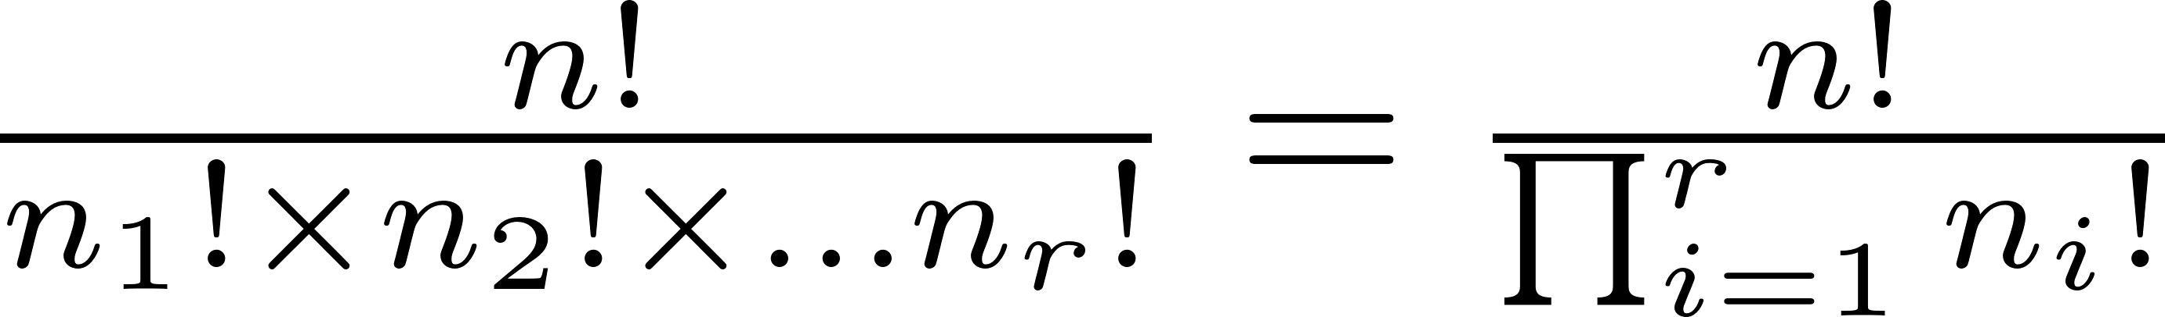
Permutations with Indistinct Objects
Given n objects, with n₁ the same, n₂, . . . n_{r} the same, the number of permutations is
Note that
CS 355/555 Probability and Statistics for CS
20/29 16:08

Slide 49
Permutations with Indistinct Objects (Optional)
Given n objects, with n₁ the same, n₂, . . . n_{r} the same, the number of permutations is
Note that
How many ways can I rearrange all the letters in Mississippi?
CS 355/555 Probability and Statistics for CS
20/29 16:08

Slide 50
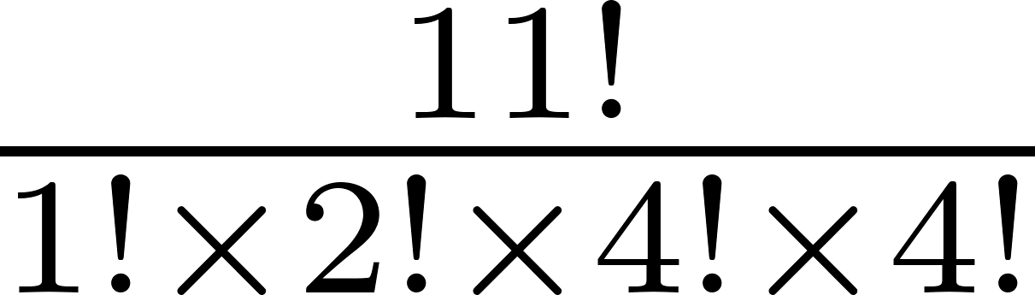
Permutations with Indistinct Objects**
Given n objects, with n₁ the same, n₂, . . . n_{r} the same, the number of permutations is
Note that
How many ways can I rearrange all the letters in Mississippi?
CS 355/555 Probability and Statistics for CS
20/29 16:08

Slide 51
I have n objects, I want to pick m of them, and it doesn’t matter what order.
Combinations
CS 355/555 Probability and Statistics for CS
21/29 16:08

Slide 52
Combinations
I have n distinct objects, I want to pick m of them, and it doesn’t matter what order.
Without replacement:
n!
_{n}C_{m} = C(n, m) = _{m!(n − m)!}
This is called n choose m
New Notation!!!
CS 355/555 Probability and Statistics for CS
21/29 16:08

Slide 53
Combinations
I have n objects, I want to pick m of them, and it doesn’t matter what order.
Without replacement:
n!
_{n}C_{m} = C(n, m) = _{m!(n − m)!}
This is called n choose m
New Notation!!!
with replacement
_{n}m m!
https://www.mathsisfun.com/combinatorics/combinations- permutations.html
CS 355/555 Probability and Statistics for CS
21/29 16:08

Slide 54
Combinations
Theorem
If 0 < k < n then
( )
n n − k
n
( )
=
k
CS 355/555 Probability and Statistics for CS
22/29 16:08

Slide 55
Combinations
Theorem
If 0 < k < n then
n n − k
( )
( )
n
=
k
Proof:
( )
( )
n
n! n!
n
=
=
=
k
k!(n − k)! (n − (n − k))!(n − k)!
n − k
CS 355/555 Probability and Statistics for CS
22/29 16:08

Slide 56
Combinations
Theorem
If 0 < k < n then
( )
( )
( )
n
n − 1
n − 1
=
+
k
k
k − 1
CS 355/555 Probability and Statistics for CS

Slide 57
Combinations - Proof of Theorem
( )
n − 1
k
( )
n − 1
(n − 1)! (n − 1)!
+
=
+
k − 1
k!(n − 1 − k)! (k − 1)!(n − 1 − k + 1)!
CS 355/555 Probability and Statistics for CS

Slide 58
Combinations
Proof:
n − 1
k
( )
( )
n − 1
(n − 1)! (n − 1)!
+
=
+
k − 1
k!(n − 1 − k)! (k − 1)!(n − 1 − k + 1)!
(n − 1)! (n − 1)!
= +
k!(n − 1 − k)! (k − 1)!(n − k)!
CS 355/555 Probability and Statistics for CS

Slide 59
Combinations
Proof:
( )
n − 1
k
( )
n − 1
(n − 1)! (n − 1)!
+
=
+
k − 1
k!(n − 1 − k)! (k − 1)!(n − 1 − k + 1)!
(n − 1)! (n − 1)!
= +
k!(n − 1 − k)! (k − 1)!(n − k)!
(n − 1)!(n − k) k(n − 1)!
k!(n − k)! ⁺ k!(n − k)!
=
CS 355/555 Probability and Statistics for CS

Slide 60
Combinations
(n − 1)!(n − k) k(n − 1)!
k!(n − k)! ⁺ k!(n − k)!
=
CS 355/555 Probability and Statistics for CS
27/29 16:08

Slide 61
Combinations
(n − 1)!(n − k) k(n − 1)!
k!(n − k)! ⁺ k!(n − k)!
=
(n − 1)!(n − k) + k(n − 1)!
=
k!(n − k)!
CS 355/555 Probability and Statistics for CS
27/29 16:08

Slide 62
Combinations
(n − 1)!(n − k) k(n − 1)!
k!(n − k)! ⁺ k!(n − k)!
=
(n − 1)!(n − k) + k(n − 1)!
=
k!(n − k)!
n(n − 1)! − k(n − 1)! + k(n − 1)!
=
k!(n − k)!
CS 355/555 Probability and Statistics for CS
27/29 16:08

Slide 63
Combinations
(n − 1)!(n − k) k(n − 1)!
k!(n − k)! ⁺ k!(n − k)!
=
(n − 1)!(n − k) + k(n − 1)!
=
k!(n − k)!
n(n − 1)! − k(n − 1)! + k(n − 1)!
=
k!(n − k)!
n(n − 1)!
=
k!(n − k)!
CS 355/555 Probability and Statistics for CS
27/29 16:08

Slide 64
Combinations
(n − 1)!(n − k) k(n − 1)!
k!(n − k)! ⁺ k!(n − k)!
=
(n − 1)!(n − k) + k(n − 1)!
=
k!(n − k)!
n(n − 1)! − k(n − 1)! + k(n − 1)!
=
k!(n − k)!
n(n − 1)!
=
k!(n − k)!
n!
=
k!(n − k)!
CS 355/555 Probability and Statistics for CS
27/29 16:08

Slide 65
Combinations
(n − 1)!(n − k) k(n − 1)!
k!(n − k)! ⁺ k!(n − k)!
=
(n − 1)!(n − k) + k(n − 1)!
=
k!(n − k)!
n(n − 1)! − k(n − 1)! + k(n − 1)!
=
k!(n − k)!
n(n − 1)!
=
k!(n − k)!
n!
=
k!(n − k)!
( )
n
=
k
CS 355/555 Probability and Statistics for CS
27/29 16:08

Slide 66
5-card hands
A deck of cards has 52 cards: four As, four 2s, four 3s, ... for 13 distinct sets of four each. How many 5-card hands have
One pair:
a, a, b, c, d
where a = a and a, b, c, d are distinct. Three of a kind:
a, a, a, b, c
CS 355/555 Probability and Statistics for CS

Slide 67
5-card hands
What is the probability that a randomly drawn 5-card hand is a full house?
CS 355/555 Probability and Statistics for CS

Slide 68
5-card hands
What is the probability that a randomly drawn 5-card hand is a full house?
Randomly generate a 5-card deck
Check if this is a full house
#(full house)/#(total trials)
CS 355/555 Probability and Statistics for CS

Slide 69
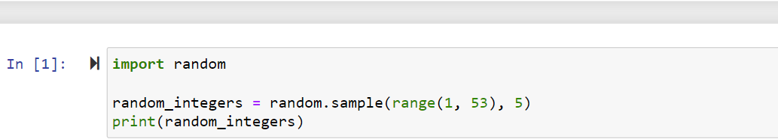
5-card hands
CS 355/555 Probability and Statistics for CS

Slide 70
Next Class
Bernoulli and Binomial random variables
CS 355/555 Probability and Statistics for CS

